Slide 1
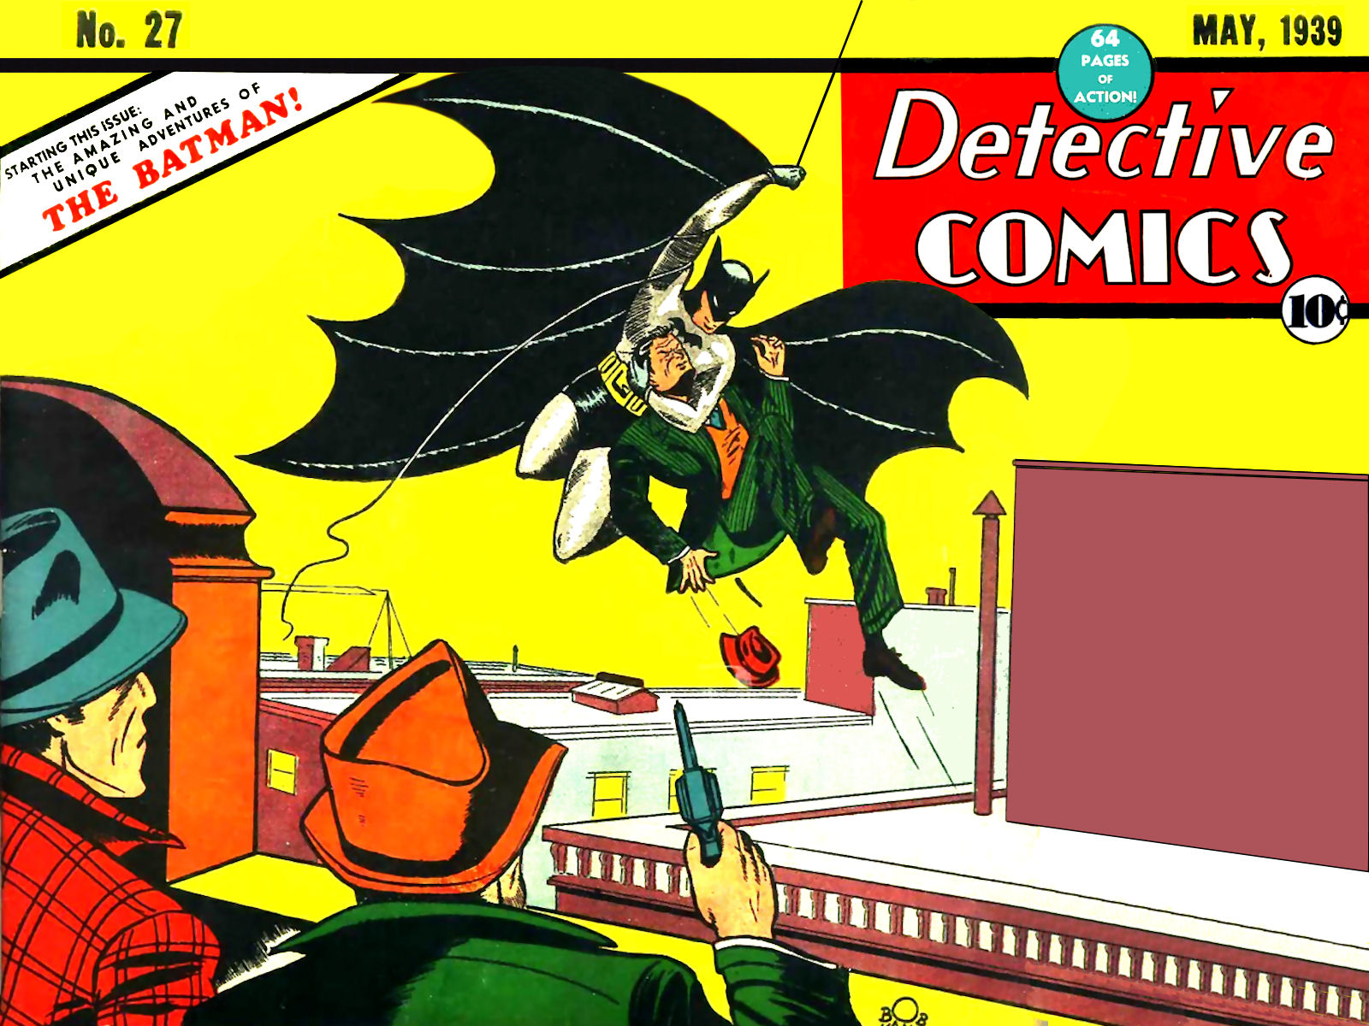
Workplace Investigations: Be The Batman
Zachary B. Allie
Notes:
Intro – Zachary Allie by day; By night, I am someone whose spouse should never leave them alone in Target the day after Halloween.
Discuss general concepts and tactics for workplace investigations that may come up due to allegations of harassment, discrimination, retaliation, safety and other types of personnel complaints.
Important because employers are legally mandated to investigate certain complaints.
Conducting workplace investigations is one of the most challenging duties that HR professionals must take on.
Workplace demographics are shifting.
New developments in the law are constantly popping up.
Managers will make mistakes because they are not properly trained or they are under pressure to resolve complaints quickly.
A poorly conducted investigation can cost an employer financially and damage its reputation, not to mention the reputations of the HR professionals tasked with overseeing the investigation
Why Batman? In the comic universe, Batman is known as “The World’s Greatest Detective” and a “Master Tactician” and all without any superhuman powers. ALSO, I really wanted to use Comic Sans in a presentation.
Throughout presentation I will have some trivia questions and some small prizes for correct answers
TRIVIA QUESTION: Bruce Wayne’s Name Comes from Two Real Heroes: Who?
Robert the Bruce, a Scottish national hero
Mad Anthony Wayne, a hero of the American Revolution.
ALT. QUESTION: Name the artist or writer that created Batman? Artist – Bob Kane; Writer – Bill Finger (1939).

Slide 2
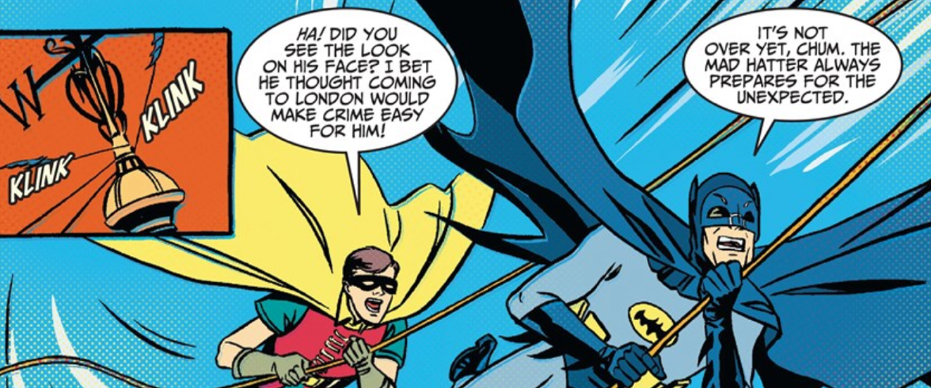
Ten Common Investigation Mistakes
Not having a plan
Ignoring complaints
Delaying investigation
Not being objective
Not listening
Being too aggressive
Not being thorough
No Conclusion
No written report
No follow-up
Notes:
All important but I will focus on a few –
First, do not ignore complaints or unreasonably delay an investigation, because –
One goal is to establish an affirmative defense:
Once ER knows or should know of violation it is investigated and prompt, remedial action reasonably calculated to correct the problem is taken.
Make sure you bring some closure to the process with a written report and following up:
Even if a written report is not part of the final decision process, going through the process with confirm you know the issues and have properly investigated the matter to come up with a factual conclusion and recommendation to address it
Follow-up is important because employers have to be aware of how the parties to the investigation are responding
There cannot be any retaliation for certain complaints and retaliation can take on many forms.
You are also creating this open door environment where a participant in the process cannot later explain why they did not take advantage of the system later on

Slide 3
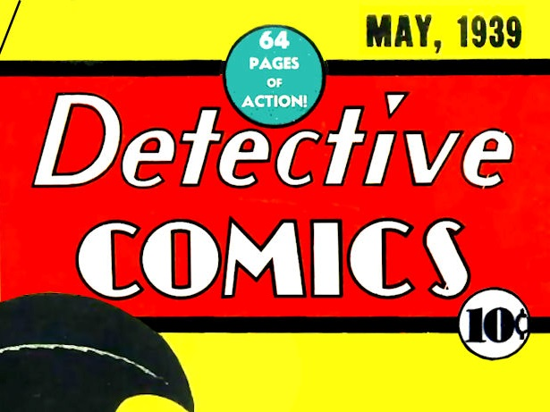
Have
A
Plan
Who will conduct the investigation?
What is being investigated?
What evidence do you have?
What evidence do you need?
Who will be interviewed?
Notes:
Do not delay your investigation BUT…
Do not be tempted to immediately start scheduling interviews. There is a quagmire of potential landmines that you have to navigate through and you do not always know that when you are heading into the investigation.
Good detectives will first create a plan that answers these questions.
Who? – Supervisor, HR, In House Counsel (privilege issues), Outside Investigator (Non-Attorney v. Attorney) (QPQ or HWE)
Role of Investigator? – Be Nuetral, Gather Information, Who present information to?, Draw conclusions?, Make Recommendations?
If know investigator may not know all the facts, may want to avoid conclusions (potential down sizing)
You need to clearly define the purpose and scope of the investigation. If you do not, you will get off track.
Be aware of any conflict of interest and realize any situations that you are too close to and cannot be objective.

Slide 4
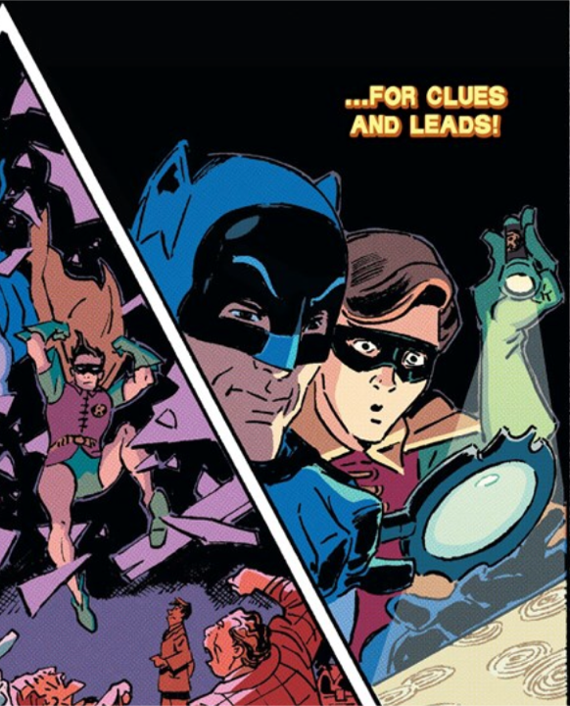
Starting the Investigation
Do not rush…
Address safety
Gather evidence
Plan the order of interviews
Notify supervisors & Line up witnesses
Prepare structured & open ended questions
Review applicable policies
Find a quiet, secure place
Notes:
Safety Concerns? Emergencies, emotionally volatile situations, violence (Call the police if there is assault or threat)
Enlighten the Accused – “A concern has been expressed, and an investigation will be done: Do not: (i) confront or apologize; (ii) recruit witnesses; Do (i) avoid questionable conduct; and (ii) get approval before any adverse action.
Gather evidence: Whether it validates the complaint or not. It will help you understand the situation and witnesses and help you be objective.
TIP: If someone hands you a document, write on the back of it who gave it to you and when.
Structured interview: Ask the same questions of each candidate. This will ensure fairness and give you a good basis for comparison. You can follow up the answers with individualized requests for clarification.
Open ended: You can warm up with a few yes/no questions, but open ended questions will give you more useful information

Slide 5
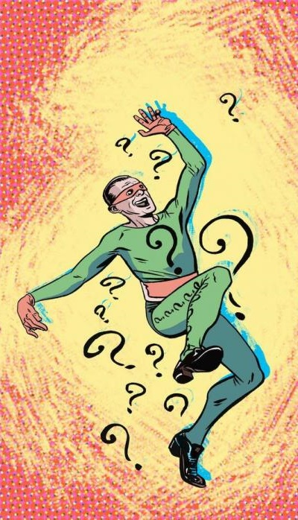
Starting the Interviews
Garrity warnings
Ease into them with Small talk
Explain:
process, issue & goal
importance of candor & complete responses
“Any questions before we dive in?”
Notes:
Issue a Garrity warning for public employees: (i) if the EE could be disciplined for refusing to cooperate; and (ii) the information sought may foreseeably be used to prosecute the employee criminally.
TRIVIA QUESTION: Who directed the first-ever Batman movie?
Andy Warhol directed Batman Dracula in 1964 without the consent of DC Comics

Slide 6
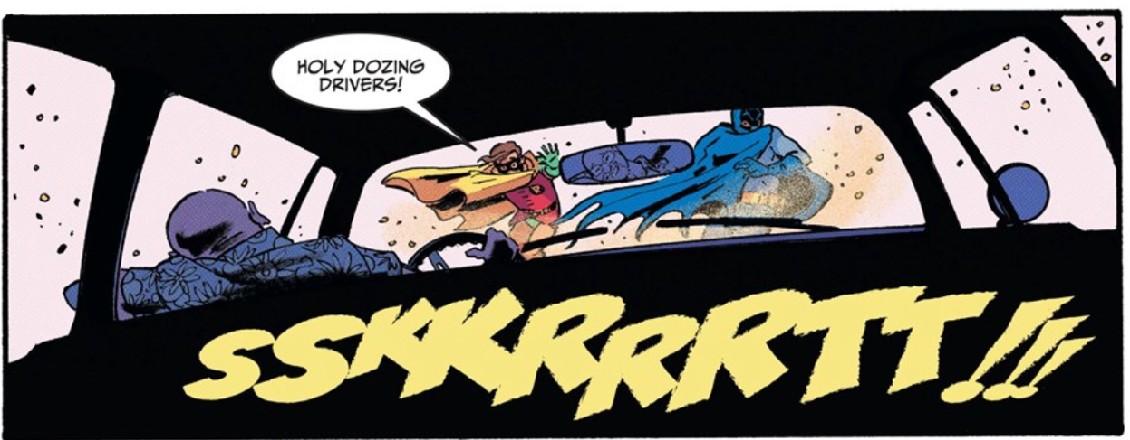
The Interviews
Remain neutral
Make no assumptions without back-up
Instead of recording interviews consider a second interviewer
Listen!!!
Silence may be golden
Monitor nonverbal communications
“Can you tell me more about that?”
Notes:
Look at interviewee expectantly and wait for more.
Strike a balance between confronting people who are lying and coaxing a reluctant person to share and give you a statement so that you have other evidence to substantiate the allegations.

Slide 7
Completing the Interview
Explain:
Importance of confidentiality
Zero tolerance for retaliation
Open door policy
Ask the complainant what they want
Ask if they have any questions
Thank them
Complete your notes ASAP
Notes:
Keep your future witnesses happy
Some people will not be happy regardless of the decision you make, but being sure you go about it in a way that is sensitive and meaningful can help diminish their dissatisfaction. They may not be happy with the answer, but at least they feel they’ve been heard.
Encourage all those involved in the investigation to keep the proceedings confidential to protect the integrity of the process. If word leaks out, other employees will lose trust and might refuse to share what they know.
A word of caution is in order for the HR team as well.
Never share information with a colleague if he or she wasn’t directly involved. It’s not that you can’t trust your colleagues. It’s about mitigating risk whenever possible.
However, don’t promise an employee that his or her complaint will remain confidential, because it might be necessary to share the information down the road.

Slide 8
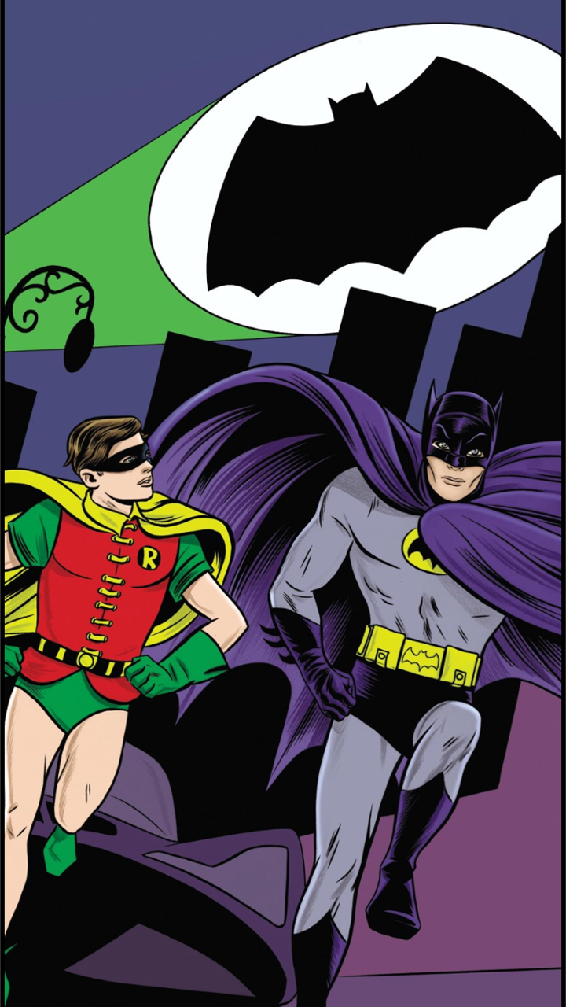
the Signals of
Witness Credibility
Plausibility:
which version is believable?
Which version makes sense?
Demeanor:
Does the witness appear to be telling the truth?
What does their body language tell you?
Corroboration:
Which version do the documents or witnesses support?
Is the witness being consistent?
Past Record:
Has the alleged wrongdoer previously engaged in inappropriate conduct?
How has the witness reacted to previous investigations?
Notes:
EEOC suggest using the following factors to assess witness credibility.

Slide 9
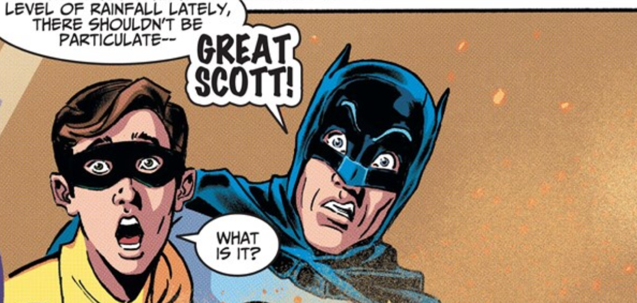
Something is
Missing
Unresolved issues
Vague policies or procedures
Missing evidence
Missing witnesses
Notes:
Being objective may have identified other issues that need to be resolved or problems with current policies and procedures that will need to be changed.
TRIVIA QUESTION: What actor has played Batman more than any other person in any form of media (film, voice, etc.)?
Kevin Conroy (voice actor) – Batman: The Animated Series, 8 TV Series, 13 animated movies, and 10 video games

Slide 10
Reach a Conclusion
Weigh the evidence and witness statements
Conclude whether policies or procedures were violated or if misconduct occurred
Notes:
People don’t want to decide that someone’s not telling the truth. It’s human nature. We don’t want to call someone a liar.
The standard for workplace investigations is “preponderance of the evidence.” Is it more likely than not that the incident occurred?

Slide 11
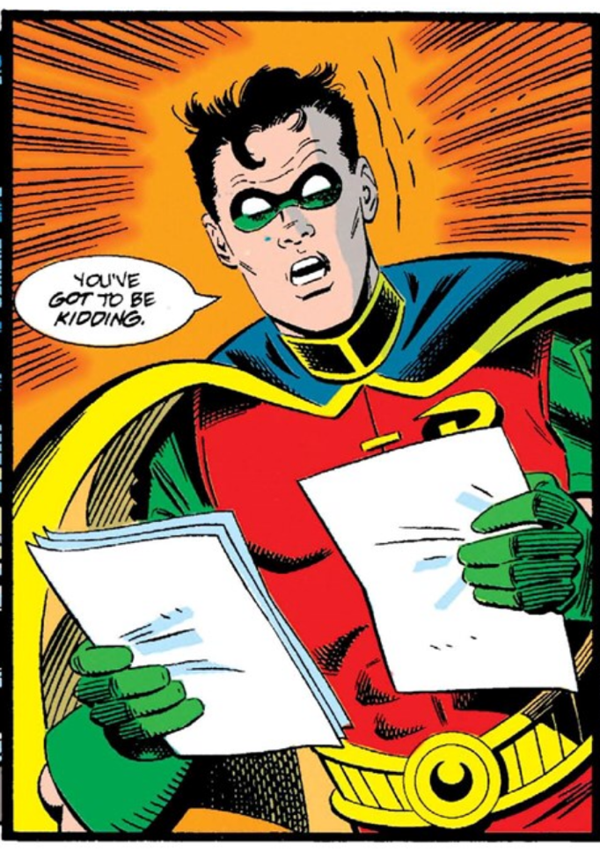
The Investigation Report
Should cover:
Issues & policies being investigated
Parties & witnesses involved
Factual findings & chronology of events
Summary of witness statements
Any credibility determinations
Reaches a specific conclusion
Identifies issues that could not be resolved
Names the final decision maker
Explains the actions taken or that will be taken by the employer
Notes:
TRIVIA QUESTION: There have been at least five incarnations of Robin’s character. Name one of his daytime personas:
Dick Grayson
Jason Todd
Tim Drake
Stephanie Brown
Damian Wayne
Helena Wayne (Earth 2)

Slide 12
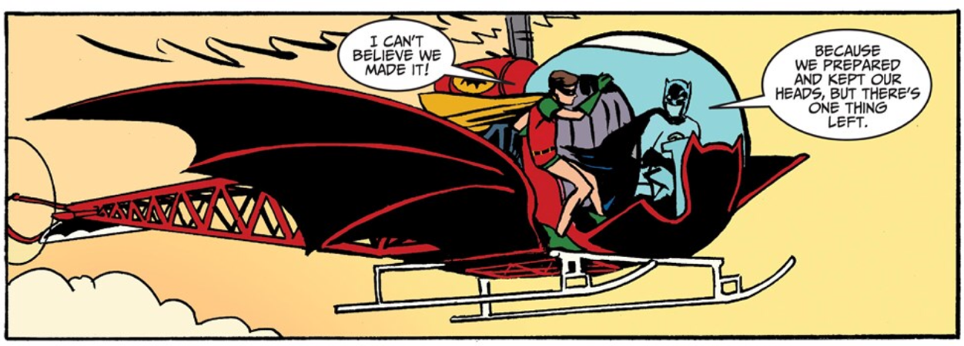
The Follow-up
Submit report to the decision maker for action
Notify complainant when action has been taken
Reintegrate and train the wrongdoer
Review investigation for improvement opportunities
Be aware of retaliation
Look for patterns
Notes:
Decision maker needs to be able to determine how people in similar situations have been treated.
Ask the complainant for a reaction
Beware of retaliation and train and notify supervisors to beware of retaliation.
Well-defined, consistent process in place can help ward of future lawsuits.
Goal should be to discourage any victims from resigning – constructive discharge

Slide 13
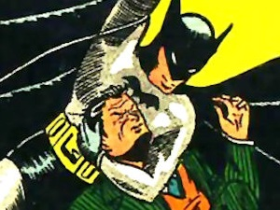
ANY QUESTIONS?
Zachary B. Allie - zallie@olsonllp.com
Notes:
TRIVIA QUESTION: Who is the only actor ever to wear both the Batman suit and the Superman suit in two different files?
Ben Affleck: Batman v. Superman: Dawn of Justice and Hollywoodland
ALT QUESTION: Name 3 “actors” that have portrayed Batman in film or television:
Lewis Wilson
Robert Lowery
Adam West
Michael Keaton
Val Kilmer
George Clooney
Christian Bale
Ben Affleck

