Slide 1
WHEN LEGAL CLAIMS ARISE . . .
What To Do And Why
Andrea Chan, Olson & Olson LLP
Notes:
My goal today is not to share with you anything earth-shattering revelations, but to help remind you, as the direct contact for your governmental entity or department, you are the link to the ones who are directly dealing with the claims. For most of you, litigation is not part of your every day life. But, it is for me. What I’d like to do today is to give you some tips on how to make dealing with claims and the litigation that follows more bearable and to help make the whole claims/litigation process more efficient, saving everyone time, money and frustration.
Most of my comments are probably going to be geared toward tort-type claims, but many of the tips will apply to other types of claims, such as employment or breach of contract.
Please feel free to comment or ask questions as I go through the tips.

Slide 2
WHEN LEGAL CLAIMS ARISE . . .
Is there really a claim? Could it be our fault?
An incident occurred
Involved in
Written notice received
A lawsuit served/Administrative proceeding initiated
A complaint received
Notes:
Briefly, so we’re all starting from the same place, we need to answer the question: “Is there really a claim?” Perhaps the more accurate question is: “Did something happen and is it our fault?” Obviously, when something like an accident between a city vehicle and another vehicle, we will probably treat it like a claim. It’s pretty easy if we receive written notice, such as a letter or email that outlines the details of a complaint or warns of a potential breach of contract.
It’s also pretty easy when we’re served with a lawsuit or given notice of some type of administrative proceeding. This could have something to do with utility rates, a breach of contract, or
The trickier situation is if there’s some complaint line or like we have in Houston 311 or an off hand comment to a city worker? Will that be enough to give us notice of a claim? The answer is maybe. It is enough to give us notice of a claim if the one of the job responsibilities of the person who received the complaint is to conduct some kind of investigation or to get someone to conduct an investigation.

Slide 3
WHEN LEGAL CLAIMS ARISE . . .
Who’s going to handle it?
Does an insurance policy cover it?
Check with your risk manager
File a claim
No insurance or not a covered claim
Handled in-house?
If not, who directs the litigation?
Who assists with discovery?
Any potential conflict among parties?
Notes:
If your entity has insurance coverage through an insurance carrier, such as TML-IRP, you’re going to want to make sure to follow the carrier’s claim procedures as soon as possible.
If it’s not a covered claim or there’s no insurance—I know some of your entities are self-insured, you’re going to have to determine whether it is something handled by your usual legal counsel or something you’re going to have a firm such as O&O handle on your behalf. Obviously, if it’s handled in-house, that attorney will deal with everything.
But, if it’s handled either through your insurance carrier or an outside firm, who will direct the litigation? Who has the authority to settle? Your entity may have specific limits that lets someone other than your governing body, such as a board or council, settle claims that fall within certain ranges. If it’s not a monetary settlement, who would approve it? If you have insurance coverage, your coverage documents usually specify who has the right to authorize settlement. With respect to discovery in a lawsuit, there should probably be one person within your entity who will act as the liaison between counsel and the entity to help schedule deposition and find documents.
Finally, you may need to consider whether there is a conflict. This could be a conflict between the entity and an employee, depending on how the claim is framed. Or, it could be that there is only insurance coverage for the entity itself, not its employees, board member, or whoever. But, later today, Leah will be speaking more about “who is the client” and she can give you more information on this topic.

Slide 4
WHEN LEGAL CLAIMS ARISE . . .
Document Retention/Public Information
Preserve the data
Suspend regular retention schedules
Identify/Explain documents already destroyed
Documents Disclosed Pre-Litigation
Keep a copy of the documents disclosed
Provide a copy of documents disclosed
Documents Requested Post-Litigation
Direct request to handling attorney
Seek a litigation exception from AG
Notes:
Probably the most time consuming part of facing a claim is dealing with the data and documents. As governmental entities, I’m sure that your custodian of records is well aware of the document retention schedule. Most governmental general counsel will advise that documents should be destroyed on the retention schedule. That is generally good advice from a general counsel point of view. As a litigator, most of the time, I want to have access to everything. I tend to believe that most documents help. And it’s perfectly acceptable to explain that documents have been destroyed pursuant to the retention schedule. HOWEVER, if there is a claim, there is likely a request from a claimant that documents be preserved. So, custodians of records must be notified of what documents should not be destroyed during the pendency of a claim/litigation. If documents are destroyed after a document retention request has been made, it is going to be much more difficult to explain.
One of the scariest things for me as a litigator is to find out half way through a deposition that my opposing counsel has some document from my client that I have not seen—especially when I discover that opposing counsel has made an open records request but no one has provided it to me. Please make sure that your public information officer retains copies of documents that are disclosed in response to a public information request and then provide those documents to the handling attorney.
If documents pertaining to a specific claim relate to pending litigation, make sure to let the handling attorney know. If it’s the claimant seeking the information, the handling attorney will be the one to release the information. If it’s a party unrelated to the parties in litigation, then get with the handling attorney and determine whether an exception should be sought from the AG. Remember if anyone has received the documents through an open records request, others can obtain them as well.

Slide 5
WHEN LEGAL CLAIMS ARISE . . .
Investigating the Claim
Follow a standard procedure
Identify the primary investigator
Let employees know that the main purpose of the investigation is fact-finding, not discipline
Verify all dates
Alleged claim
Investigation activities
Method of Notice
Capture as all contact information
Take photos, if applicable
Notes:
So, you may be in a position where you have a claim that may need to be investigated, even though it isn’t an actual claim. An easy example is when an entity’s vehicle is in a collision. You will need to have a peace officer’s investigation. Your entity should decide who is going to investigate the claim. I know that some cities will have its own police officers investigate the accident. Others will have DPS investigate so as to have a “neutral” investigator. Whatever you decide, be consistent. Also, during the claim-investigation stage, it is probably a good idea to let the employee know the purpose of the investigation so that the employee is candid about sharing details. If there needs to be disciplinary action, start a new investigation.
One of the most important things to do is to document everything. What can be vitally important is the date of the claim and the date of the notice. I have seen claim forms that give differing dates and the dates on the claim form are different from the claimant’s letter giving notice of the claim and the date in the lawsuit. The claimant’s representative called the risk manager for the client and gave one date as the alleged date of occurrence. It turned out none of the dates was correct: I spent a long time trying to figure out the correct dates and finally corroborated an activity log with medical records to determine the exact date. When the employee was interviewed, she was asked about specific dates that had been given. She truthfully state that the events did not happen on those dates because she was not asked whether the incident happened and on what date the incident happened.
Another thing that is very helpful is to get as much information from any witnesses as possible. People move and change jobs. Fortunately, these days, people will keep their cell numbers and email addresses. Get those and reassure people that they will not be bombarded with information.
When you take photos, make sure when you look at the photo you can tell what the photo is. Use objects to demonstrate scale. Sometimes if the photo is too close up, you get all the details, but you get no perspective.

Slide 6
WHEN LEGAL CLAIMS ARISE . . .

Slide 7
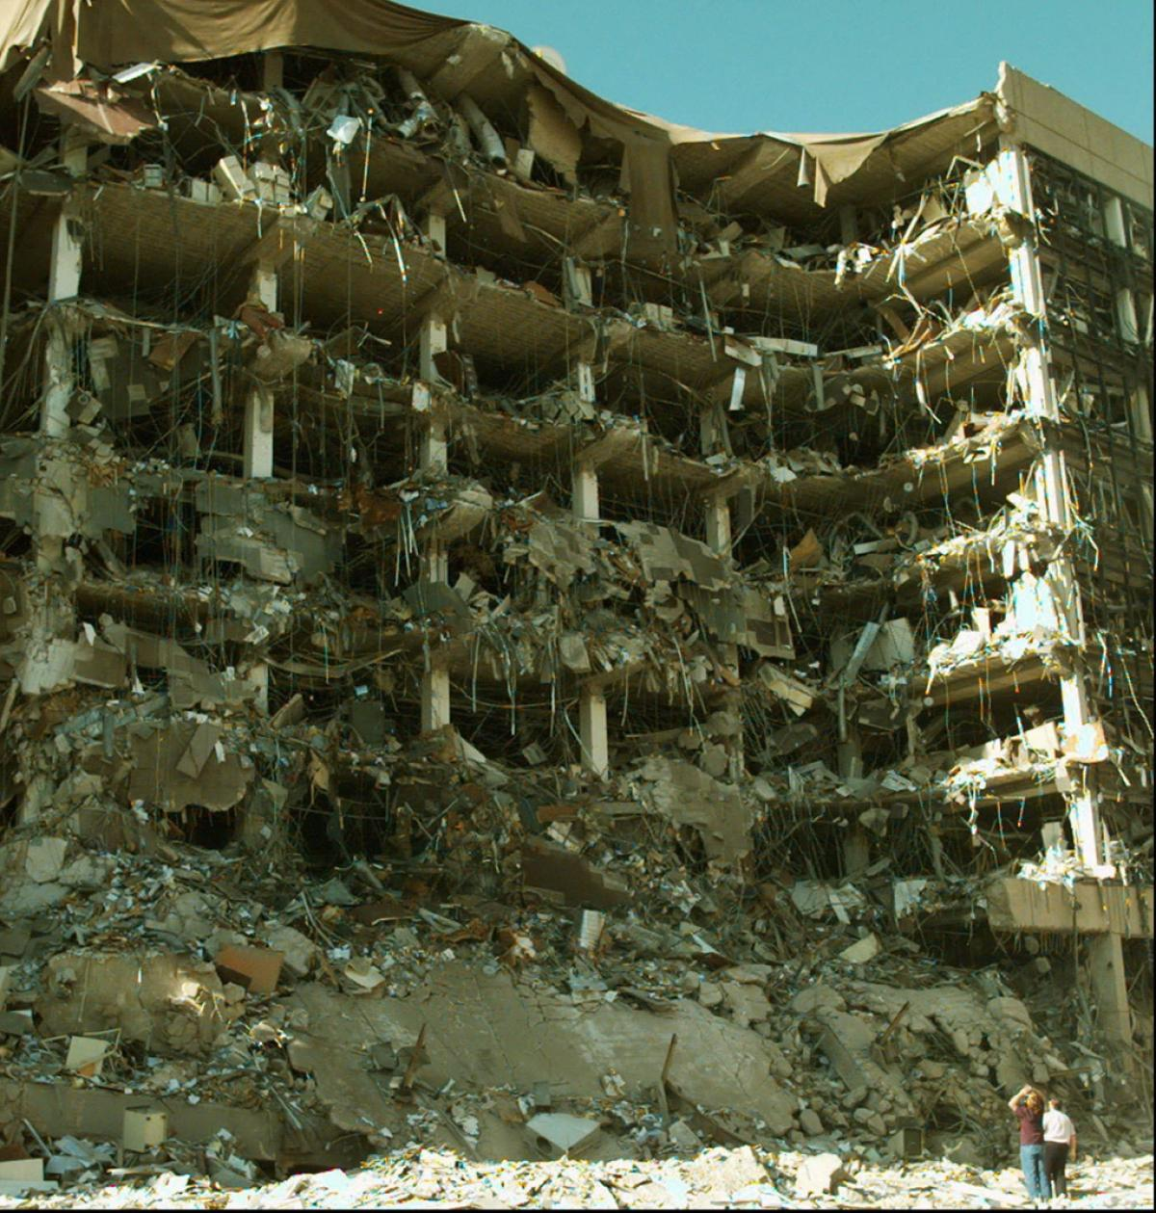
WHEN LEGAL CLAIMS ARISE . . .

Slide 8
WHEN LEGAL CLAIMS ARISE . . .
The Discovery Process
Identify all relevant ordinances, codes, statutes, rules, policies, orders, SOPs, etc.
Ask every employee remotely connected to the subject matter for anything
If in doubt regarding responsiveness, produce it with that caveat
Highlight anything that might be problematic
Take the equipment out of service
Make sure that information is “accessible”
Notes:
During the investigative process, you may have already gathered documents that are relevant. I’ve had clients start a file when they think there is going to be a claim so that when I ask for documents, they’ve got a stack ready for me. But, one of the other things that is really helpful is to tell the handling attorney about different ordinances, codes, statutes, rules, policies, orders, standard operating procedures and the like that you might have. Also let the handling attorney know if you have these things but don’t follow them.
Another thing that gets overlooked is asking everyone who might have had anything to do with an incident what documents that person might have. There might be a police officer who investigated an accident. In addition to whatever was attached to the peace officer’s report, some sort of field notes. Those could prove to be very beneficial. Or job or activity logs.
If you’re not sure that it is what you think the attorney is looking for, ask or offer examples any way. The attorney may not need it right away, but knowing its existence may be helpful in negotiating a settlement.
If you know there are problems, let the attorney know early. It could be a problem employee. Or that this same type of accident has happened before. Dealing with the problems early on can be part of the strategy.
Finally, with regard to gathering documents and other things during the discovery process, make sure that there doesn’ t need to be some special software to convert whatever digital information you have. Do the video cameras or audio use some sort of proprietary software? If so, how can it be converted so it’s usable?

Slide 9
WHEN LEGAL CLAIMS ARISE . . .
Disciplining an Employee
Follow all standard procedures
Do not treat the employee differently
Advise the handling attorney if an employee who is a key witness to the claim is disciplined
Notes:
Finally, if an employee who is an important part of the case needs to be disciplined, whether related to the particular claim at issue or something totally different, it’s important to treat the employee like any other employee in the same situation. The caveat is to let the handling attorney know as soon as possible. The attorney needs to know if that particular employee is going to be adverse or hold a grudge. Those factors can play a role in whether a claim is settled quickly to avoid the unknown impact of a disgruntled employee.

