Slide 1
Tomball Police Department Fitness Program

Slide 2
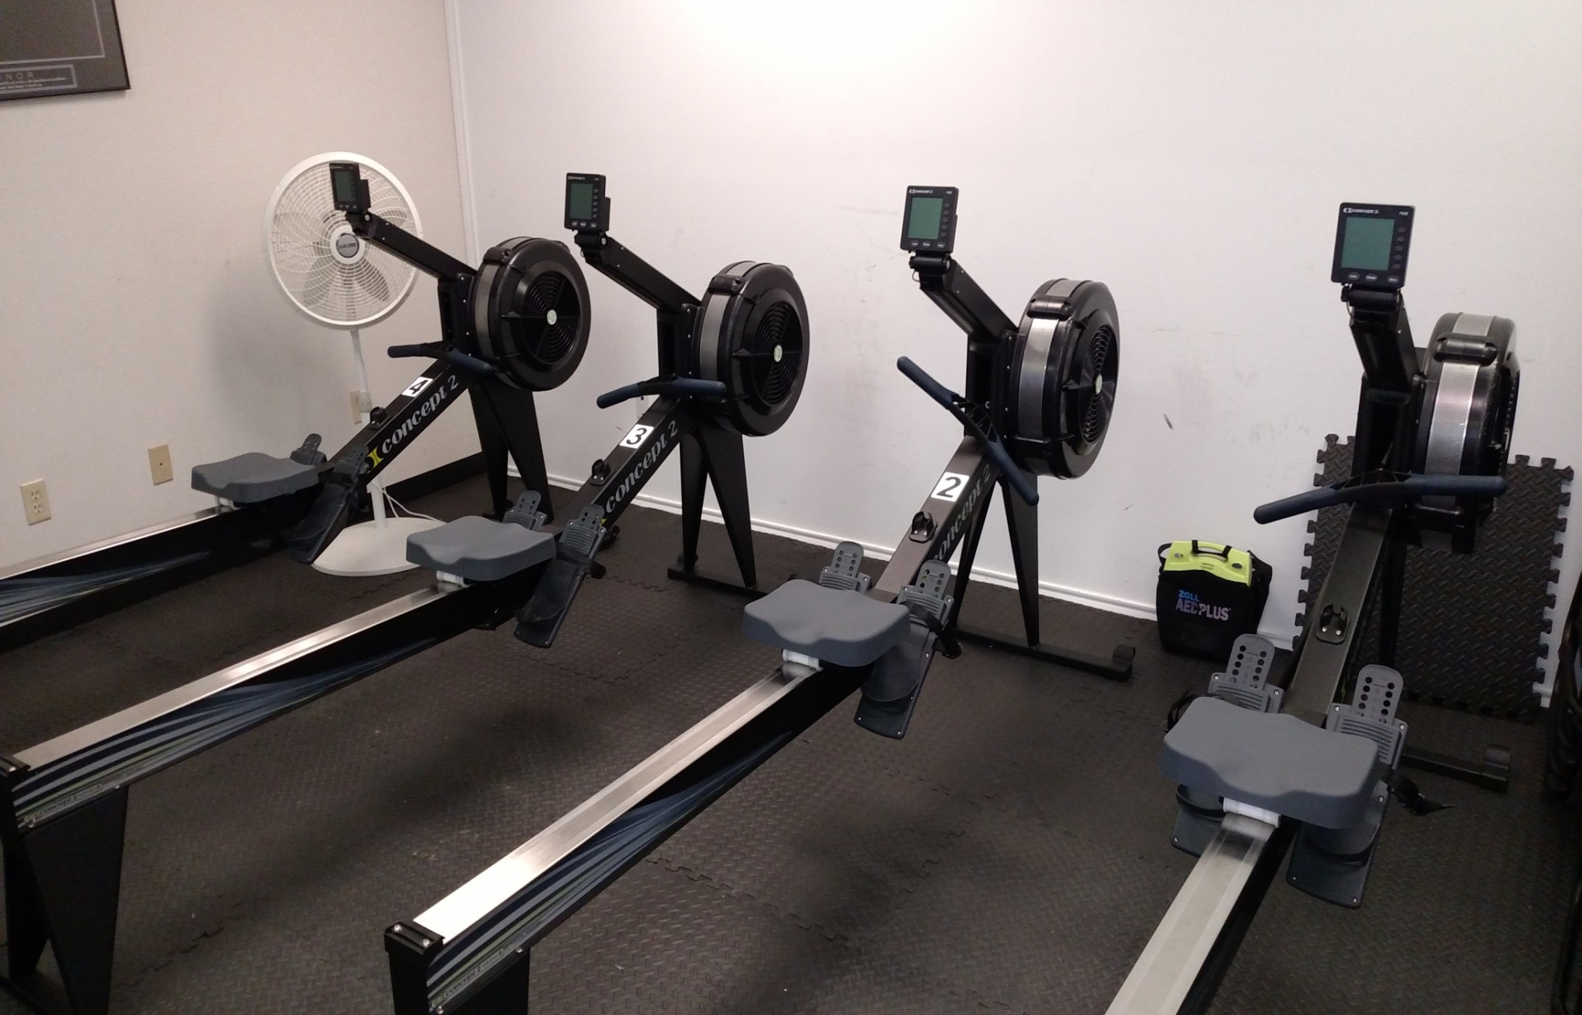

Slide 3
Past TPD Programs
No science to substantiate
No established standard
Worker’s Compensation injuries
Programs failed

Slide 4
DPS Fitness Program
Meets EEOC standards for entry level and incumbent employees
Department standards established scientifically
Total support from DPS
Olson and Olson support the program

Slide 5
VO2 max
The maximum amount of oxygen that can be consumed and used by the muscles during exercise. The higher the number, the greater a person’s aerobic fitness
On the rowing machine it is determined by age, gender, and time on a 2000 meter row. The percentage that must be met is the VO2 max.

Slide 6
Tomball PD Process
Establish policy (model provided by DPS)
Purchase rowing machines (from Concept 2)
Train trainers (It takes half a day and DPS comes to your location to provide)
Initial testing of all officers
Provide DPS the numbers on forms they provide
They establish your standard which increases as the department becomes more fit.

Slide 7
TPD Fitness Program
Difficulties
Doctor says they can’t row
Attitudes of don’t care or lets go as slow as we can and set the bar low
Solutions
If you can’t row you are not fit enough to do your job
Enforce sanctions.

Slide 8
Suggestions for Success
Partner with HR
Get buy in from supervisors and then make them responsible
Find sanctions that motivate
Find rewards that motivate
Enforce the policy.

Slide 9
Contact
Billy Tidwell, Tomball Police Department, btidwell@tomballtx.gov
Lisa Coe, HR City of Tomball, lcoe@tomballtx.gov
Captain Greg Davis, DPS, R.Davis@dps.texas.gov

